Slide 1

Who controls you?
Based on Wayne Froggatt’s ideas on personal responsibility and emotional control
Goal: turn insight into practical, everyday skill
Notes:
Set the tone: this is about gaining influence over your emotional life.
Emphasize: not self-blame—skill-building.
Invite participation: “Think of one recurring trigger you’d like to handle better.”

Slide 2
Why This Matters 🌱
Regain influence over feelings and actions
Reduce stress, blame, and reactivity
Grow confidence, resilience, and choice
Notes:
Link control → calm → better decisions.
Give a quick example (traffic, email tone).
Encourage writing down one real scenario today.

Slide 3

The Core Model: ABC 🧠
A: Activating Event (what happened)
B: Beliefs (what you told yourself about it)
C: Consequences (feelings and actions that followed) Key idea: B, not A, drives C.
Notes:
Stress the pivot: beliefs mediate emotion.
Mini example: A = late reply; B = “I’m being ignored”; C = anger.
Promise practical tools next.

Slide 4
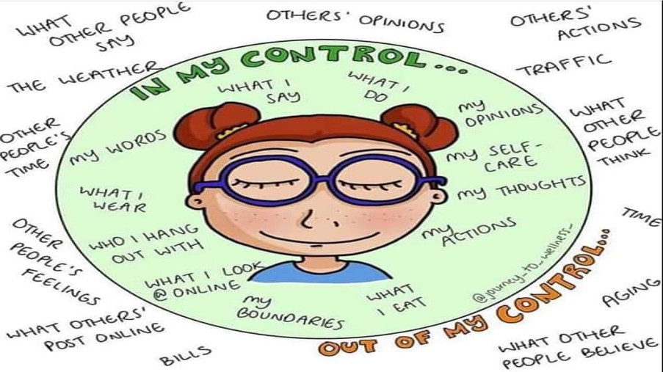
Myth: “Others Make Me Feel…” 🪄
External control belief → helplessness, resentment, passivity
Reality: beliefs produce your emotional response
Replace “They made me angry” with “I felt angry because I believed they disrespected me”
Notes:
Normalize: we all say this sometimes.
Reframe without blaming the self.
Cue: language shift = leverage.

Slide 5
Irrational Beliefs to Watch For 🚩
Demands: “Must/should” absolutism
Awfulizing: “This is unbearable/terrible”
Low frustration tolerance: “I can’t stand it”
Global ratings: “I’m a failure/They’re worthless”
Think which one you use most; catch it once daily
Notes:
Invite a quick self-scan.
Suggest noticing the first phrase that pops up under stress.
Nonjudgmental tone: curiosity over criticism.

Slide 6
Rational Beliefs (Helpful Alternatives) ✅
Preferences instead of demands
Hard, not horrible
I can stand discomfort and still act
Evaluate behaviors, not your worth
Build a personal “rational swap” card for your top trigger
Notes:
Show the swap: must → prefer; awful → hard.
Reinforce self-efficacy: “I can and will act.”
Suggest a wallet note or phone lock screen.

Slide 7
Example: Criticism at Work 💼
Manager says “This needs improvement”
Thought 1: (Irrational): “I must get approval; this proves I’m incompetent”
Feelings: Shame, defensiveness, avoidance
Thought 2 (Rational): “I prefer praise, but feedback helps me improve”
Feelings: Calm, curiosity, constructive changes
Notes:
Walk both paths out loud.
Ask audience which path they know well.
Emphasize performance improves under rational beliefs.

Slide 8
Disputing Beliefs: D → E 🔄
D: Dispute unhelpful beliefs (Is it true? Logical? Helpful?)
E: New Effect—healthier emotions, better outcomes
Three questions: Evidence? Is it catastrophic? What’s a workable next step?
Notes:
Keep it brief and repeatable.
Highlight “helpfulness” as a criterion, not just truth.
Model a 20-second dispute.

Slide 9
Language Shapes Emotion 💬
Swap
Swap “must/should” → “prefer/want”
Swap
Swap “awful” → “unpleasant but manageable”
Swap
Swap “I can’t stand it” → “I don’t like it, and I can handle it”
Track
Track one phrase swap per day for a week
Notes:
Language is a steering wheel.
Encourage micro-practice: one swap per day.
Suggest teammates/family mirror the language.

Slide 10
Responsibility vs Blame 🧭
Responsibility: owning your response and choices
Not blame: no self-attacks
It’s about influence, not fault
When upset, ask: “What small part is in my control right now?”
Notes:
Distinguish guilt vs growth.
Use the 1% rule: even tiny control matters.
Keep tone compassionate.

Slide 11
Boundaries and Choice 🛡️
Internal control ≠ tolerating bad behavior
Choices: assert, leave, negotiate, escalate
Strong boundaries reduce resentment
Draft one boundary: “If X continues, I will Y”
Notes:
Empowerment includes saying “no.”
Offer a boundary script and rehearse it mentally.
Mention HR/mediators when relevant.

Slide 12
When Control Is Genuinely Limited ⚠️
Coercion, abuse, discrimination, trauma, biology, emergencies
Your emotions are valid; safety first
REBT complements—not replaces—systemic change and support
Alternatives:
Trauma-informed care, legal/safety planning, medical support, acceptance-based skills
Notes:
Name the limits clearly and respectfully.
Emphasize safety and support networks.
Provide resources or referral pathways when applicable.

Slide 13
Different Perspectives 🧩
REBT/CBT: change beliefs → change outcomes
Acceptance-based: make room for feelings, act by values
Stoic: focus on what’s in your control
Interpersonal: relationships/culture shape emotions
Pick one lens to apply this week and journal results
Notes:
Offer choice of frameworks, not dogma.
Suggest “try-it-and-see” experimentation.
Short example per lens (10 seconds each).

Slide 14
Micro-Skills You Can Use Today ⚙️
Pause-breathe-name: “I’m noticing anger”
Ask: “What belief is driving this?”
Dispute fast: “Is there a more helpful belief?”
Act by values, not moods
Two-minute “ABCD” drill after any stressful email
Notes:
Encourage practice in low-stakes moments first.
Reinforce: consistency beats intensity.
Share a personal or anonymized example.

Slide 15

Practice Plan 📝
Daily ABC log (3–5 minutes)
Weekly review of triggers and wins
One difficult conversation using rational prep
Celebrate small gains to build momentum
Put a 5-minute “ABC check-in” on your calendar for the next 7 days
Notes:
Show a simple log format.
Celebrate adherence, not perfection.
Suggest a buddy for accountability.

Slide 16
For Leaders, Parents, Partners 🤝
Model rational language and problem-solving
1
Treat feedback as growth, not judgment
2
Reinforce effort and specific behaviours, not global labels
3
Ask: “What belief helped or hurt us here? What’s a better one?”
4
Notes:
Culture compounds individual change.
Use team rituals (retros, family check-ins).#
Praise specifics to shape learning.

Slide 17
Measuring Progress 📈
Intensity: rate emotions 0–10 (trend down)
Speed: quicker recovery
Choice: more options seen, fewer “musts”
Keep a simple 1–10 emotion tracker for 2 weeks
Notes:
Make improvement visible with numbers.
Look for trendlines, not day-to-day noise.
Review and celebrate in weekly check-ins.

Slide 18

Bottom Line ❤️
Events matter—but beliefs drive your emotional power
Dispute, reframe, and act by values
With practice, you’ll feel less pushed around—by others or your own thoughts
Choose one recurring trigger and run the ABCDE process today
Notes:
Summarize the promise: more choice, less reactivity.
One-sentence call to action.
Invite quick Q&A or a 30-second reflection.

