Slide 1

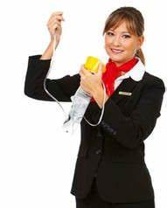
SMART Family & Friends Online Meeting

Slide 2
Welcome to SMART Family & Friends – especially if this is your first meeting!
You are welcome to join in the meeting or just listen in if you prefer. If you don’t feel comfortable speaking that is fine. You can text in the chat box to check in and out of the meeting and ask any questions that you might have.
SMART Recovery Family and Friends is a Programme
where, through open and confidential discussion, we help
ourselves and each other gain recovery from a loved one’s
addictive behaviour.

Slide 3


Room Etiquette
Using the webcam is completely optional
If you have an issue with something visible on camera, please make the Facilitator or co-host aware
If requested, we may temporarily turn off your video. You will need to ask for it to be reactivated
Please keep your microphone muted when others are speaking

Slide 4
SMART Family & Friends Meeting
Opening Statement
Welcome to this online SMART Recovery meeting for Family & Friends. In these meetings we help ourselves and each other live more fulfilled and safer lives.
We will focus on solutions or what will make our lives better and happier, rather than bad things that have happened in the past.
We will keep in mind that we are not responsible for the behaviour of our Loved One.
We believe that although people may have a problematic habit, they are more than just their behaviour, so we avoid labels, such as alcoholic or addict in our meetings.

Slide 5
SMART Family & Friends Meeting
Opening Statement (continued)
We do not see ourselves or our Loved One as “powerless” over addiction. Instead, we focus on the power of choice, our ability to change our lives and make it better. There are no guarantees, but we often find that changing our behaviour has a positive effect on our Loved Ones.
We strive to be patient but persistent in our efforts to improve our lives. It takes time to change beliefs and develop new ways of behaving around our Loved One.
Please attend meetings for as long as they are helpful. As no two meetings are ever alike, do try to come to a few before you decide how helpful SMART can be for you.

Slide 6
SMART Friends and Family
Agenda
Welcome and opening statement – 5 mins
Check in – 10 mins
Disable the enabling – 20 mins
Communication and boundaries – 20 mins
Tool time – 30 mins
Check out – 5 mins

Slide 7
SMART Friends and Family
Check in
Introduce yourself to the group
What brings you to this group?
How has it been over the last week?
What challenges have you faced?
What are you most proud of?

Slide 8
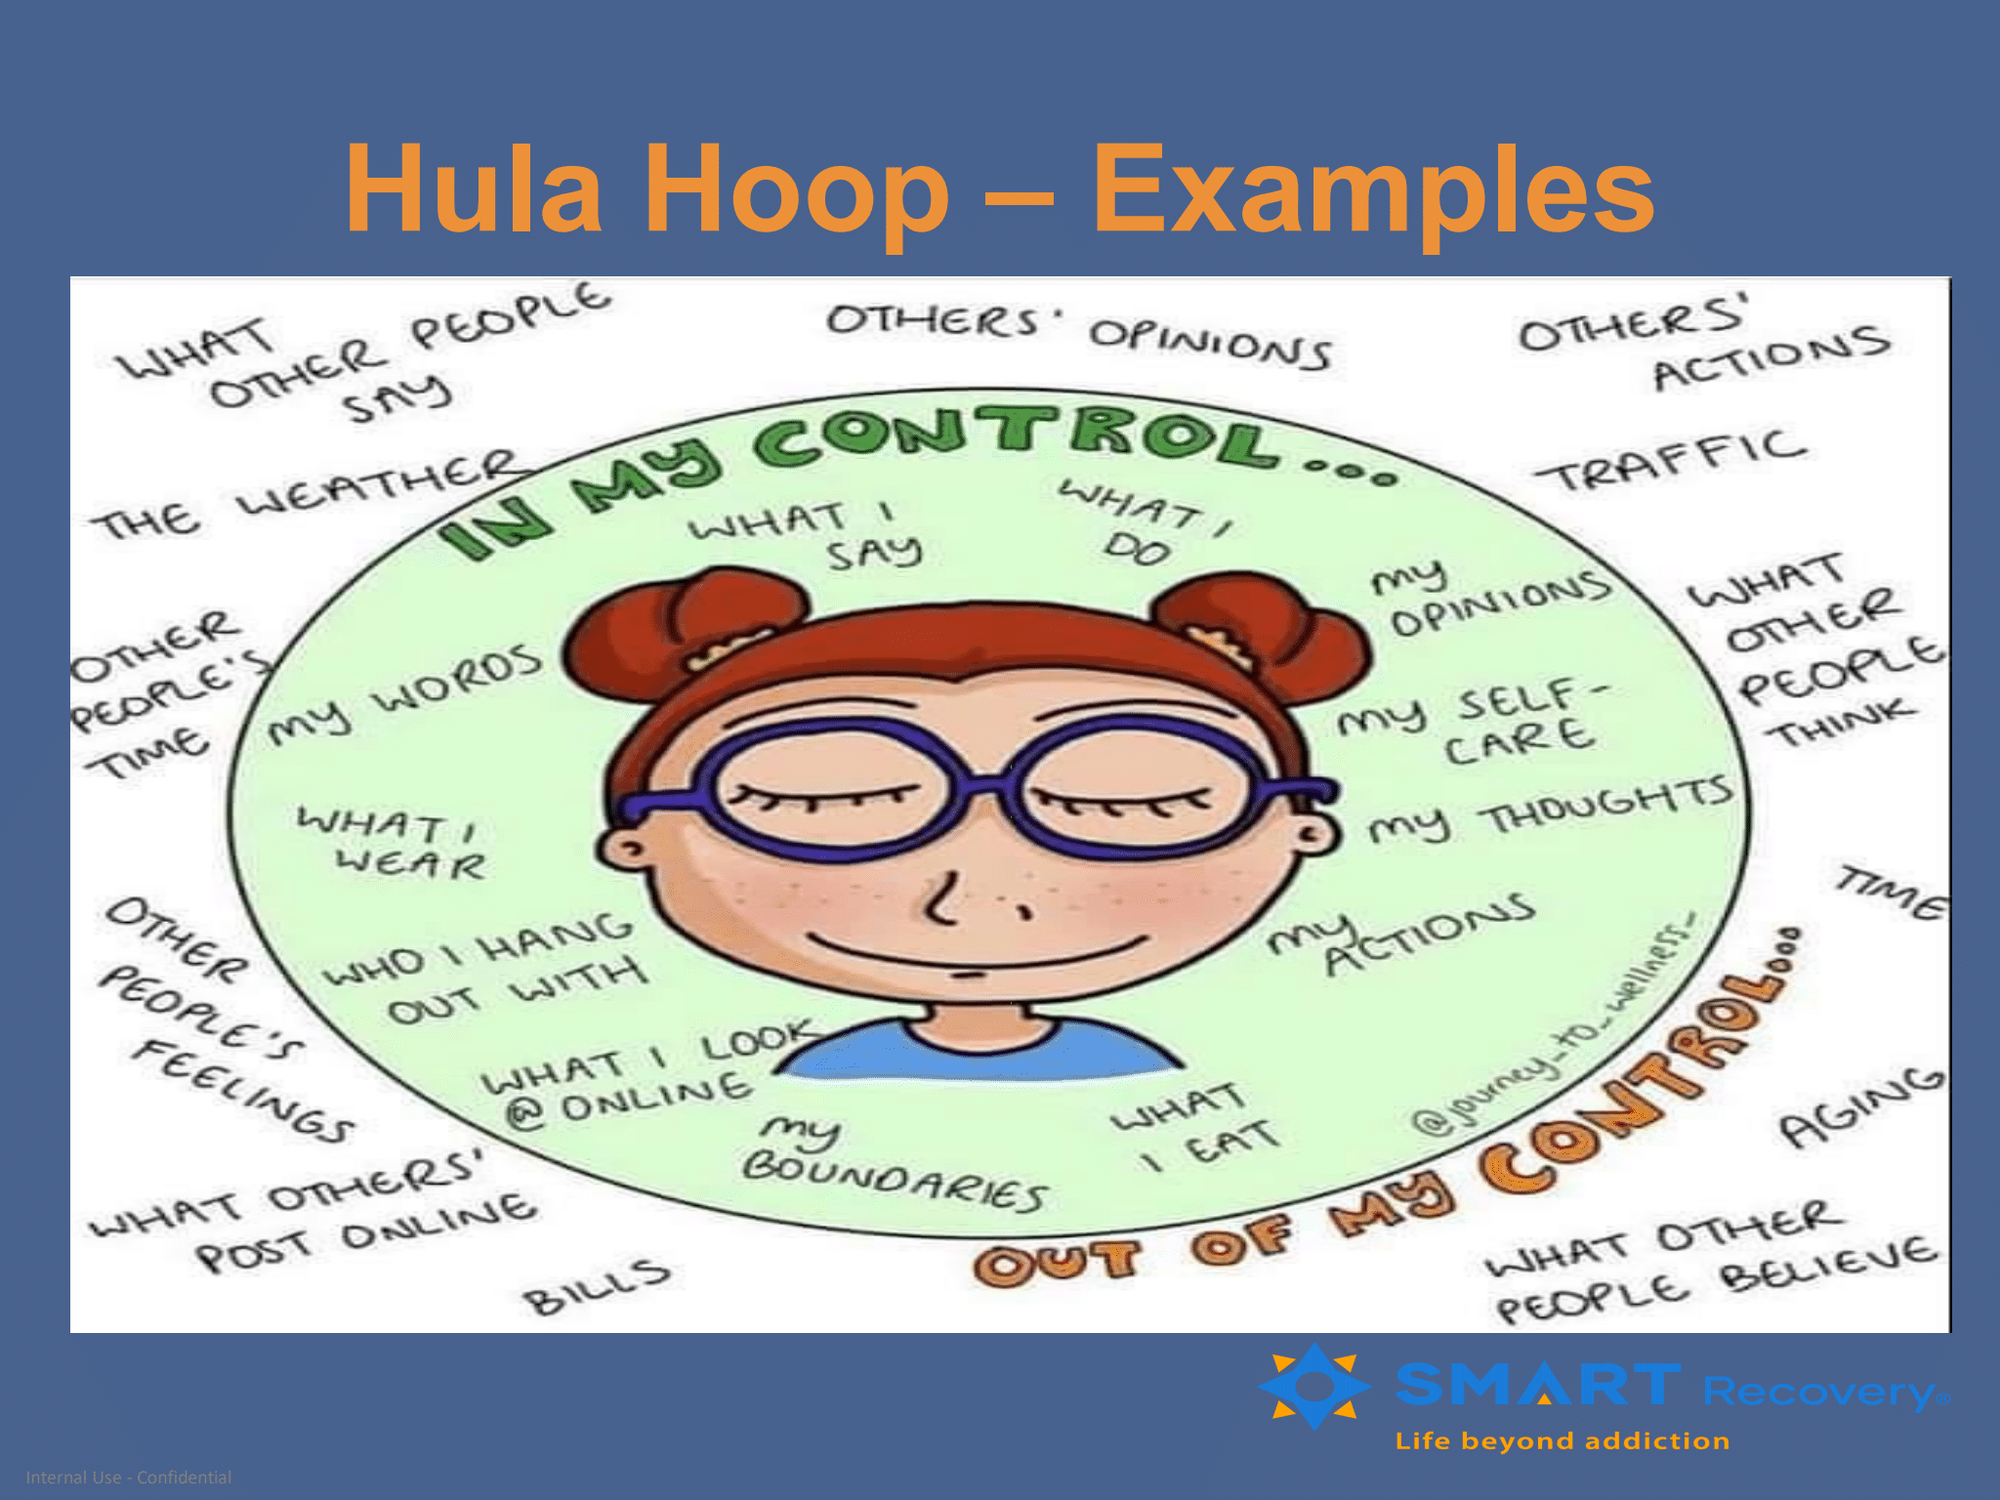

Slide 9
SMART Friends and Family
Disable the enabling
Your words may be to the contrary as you scold, nag, beg, plead, but your behaviour shouts “I’m here to make it easier for you” GYLOS
“Resign your job as manager of your LO’s addiction.”
The more you give, the more your LO takes until your life is no longer your own. Everything you do centres on either avoiding bad consequences of your LO’s behaviour, cleaning up the mess, or feeling hurt and angry that you are caught in this trap. What starts out as good intentions to help your LO turns into relationship poison as it makes drinking easier for your loved one and leaves you feeling used and angry.

Slide 10
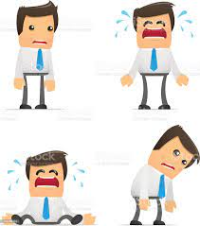
Disable the Enabling
As you have tried to help your Loved One (LO) toward recovery, you may have found yourself taking on the role of “Manager”, attempting to manage the addiction in various ways.
These are often behaviours that were well-intentioned when they began, but which may not be working well now
Resign your job as Manager
If what you are doing is not working, you may want to consider your options for “resigning your job as manager of your LO’s addiction”.

Slide 11
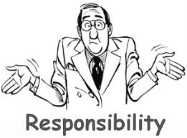
Enabling Behaviours
What is Enabling ?
Preventing a person from experiencing the NATURAL consequences of their behaviour by changing the consequences, or by accepting responsibility for them
Doing anything for our LO that they CAN AND SHOULD be doing for themselves.
Enabling is when your actions and behaviours make it easier for your LO to continue to engage in their addiction.

Slide 12
Recognise These?
“Enabling behaviours” generally fall into one of three categories:
Fixing problems: e.g. calling in sick for a LO who can’t work due to “using”
Protecting your LO: e.g. covering up for them with family, making excuses, keeping the real problem a secret
Nagging: e.g. frequently reminding your LO of “the problem” and urging them to do something about it

Slide 13
The questions below are examples of behaviours that often serve to prevent someone from
experiencing the natural consequences and repercussions of their choices to continue with
the addiction. Mark each of these as True or False:
____Have you paid bills that your Loved One (LO) was supposed to have paid?
____Do you avoid talking about your LO’s drinking or drugging out of fear of the response?
____Have you threatened to leave if your LO didn’t stop drinking and then did not leave?
____Have woken your LO so he or she would not be late for work or school?
____Have you explained, (multiple times) to your LO that he or she MUST stop
drinking/using?
____Have you bailed your LO out of prison or paid his or her legal fees?
____Have you ever helped your LO look for items they lost while drinking or using?
____Have you ever avoided making plans to spend time with family or friends because you
were concerned your LO’s behaviour would be unpleasant due to drugs or drinking?
____Have you ever cut back on your own expenses because of your LO’s substance use?
____Do you believe your LO’s lies - over and over?
____Do you accept your LO’s excuses?
____Do you allow yourself to be physically or emotionally abused by your LO?
____Do you make addictive behaviour seem “normal” to your children?
____Do you let your LO change the subject when you bring up their substance abuse
problem?
____Do you nag/plead/threaten your LO in an effort to inspire change?
____Do you keep your LO’s addiction a secret from others?

Slide 14
Disabling the Enabling Exercise
How can you overcome your impulses to fix, nag, and protect?
Start by making a list of specific things that you do that you suspect may be enabling. Now
that you are aware of some behaviours that you might want to change.
Ask Yourself:
1. Why am I doing these things? What am I telling myself about this situation that has
been making it ok for me to do these things? Some things that you may be telling
yourself:
  My LO needs my help (and I MUST help him/her)
  I can't be happy until my LO changes
  It hurts me to see this
  I’m the only one my LO trusts to help him/her fight this addiction
2. Has my behaviour been effective in solving the problem?
3. What’s stopping me from changing my enabling behaviours? For example:
  I don't want to hurt my LO
  They will be angry with me
  It's going to hurt ME to no longer protect my child
  I just don't see how it will make any difference
4. Challenge your reasons for continuing your enabling behaviours
  Will disabling the enabling truly hurt my LO? Yes, they may get angry, but what is that
  in comparison to the long-term HARM of addiction that I am working to avoid?
  What will hurt ME more: disabling the enabling, or knowing that I didn’t do anything to
  stop it?
  What can I expect to happen if I don't change? Will things get better?

Slide 15

The LIGHTHOUSE
Consider a lighthouse. It stands on the shore with its beckoning light, guiding ships safely into the harbour. The lighthouse can't uproot itself, wade out into the water, grab the ship by the stern and say, ‘Listen you fool. If you stay on this path you will break up on the rocks
No. The ship has some responsibility for its own destiny. It can choose to be guided by the light in the lighthouse. Or, it can go its own way. The lighthouse is not responsible for the ship’s decisions.
All it can do is be the best lighthouse it knows how to be.” Randi Kreger and Paul T. Mason from ‘Stop Walking on Eggshells’

Slide 16

What will happen?
Changing how you interact with your LO will feel uncomfortable at first.
This is normal. Remember just because your new behaviour may FEEL wrong, that doesn’t mean it IS wrong.
Be PATIENT with yourself,
PRACTICE what you are learning here and
Be PERSISTANT.

Slide 17

SMART Friends and Family
Communication and boundaries

Slide 18
Positive Communication
Have you tried talking to your LO about their behaviours and find yourself having the same conversations (or arguments) again and again? Are you having problems just talking to your LO about anything in a way that is nurturing and beneficial to you both?
When relationships are troubled, and many relationships where addiction is involved are troubled, there are some predictable ways that communication styles deteriorate. These changes happen in all areas of communication, not just in our communication about the addiction.
You can begin to favour negative comments, rather than positive comments, you converse in terms of “you” statements ra­ther than “I” statements and tend to disregard each other’s point of view.
Finally, both parties stop sharing responsibility for the situation and begin blaming each other.
These ineffective communication styles can be changed.

Slide 19
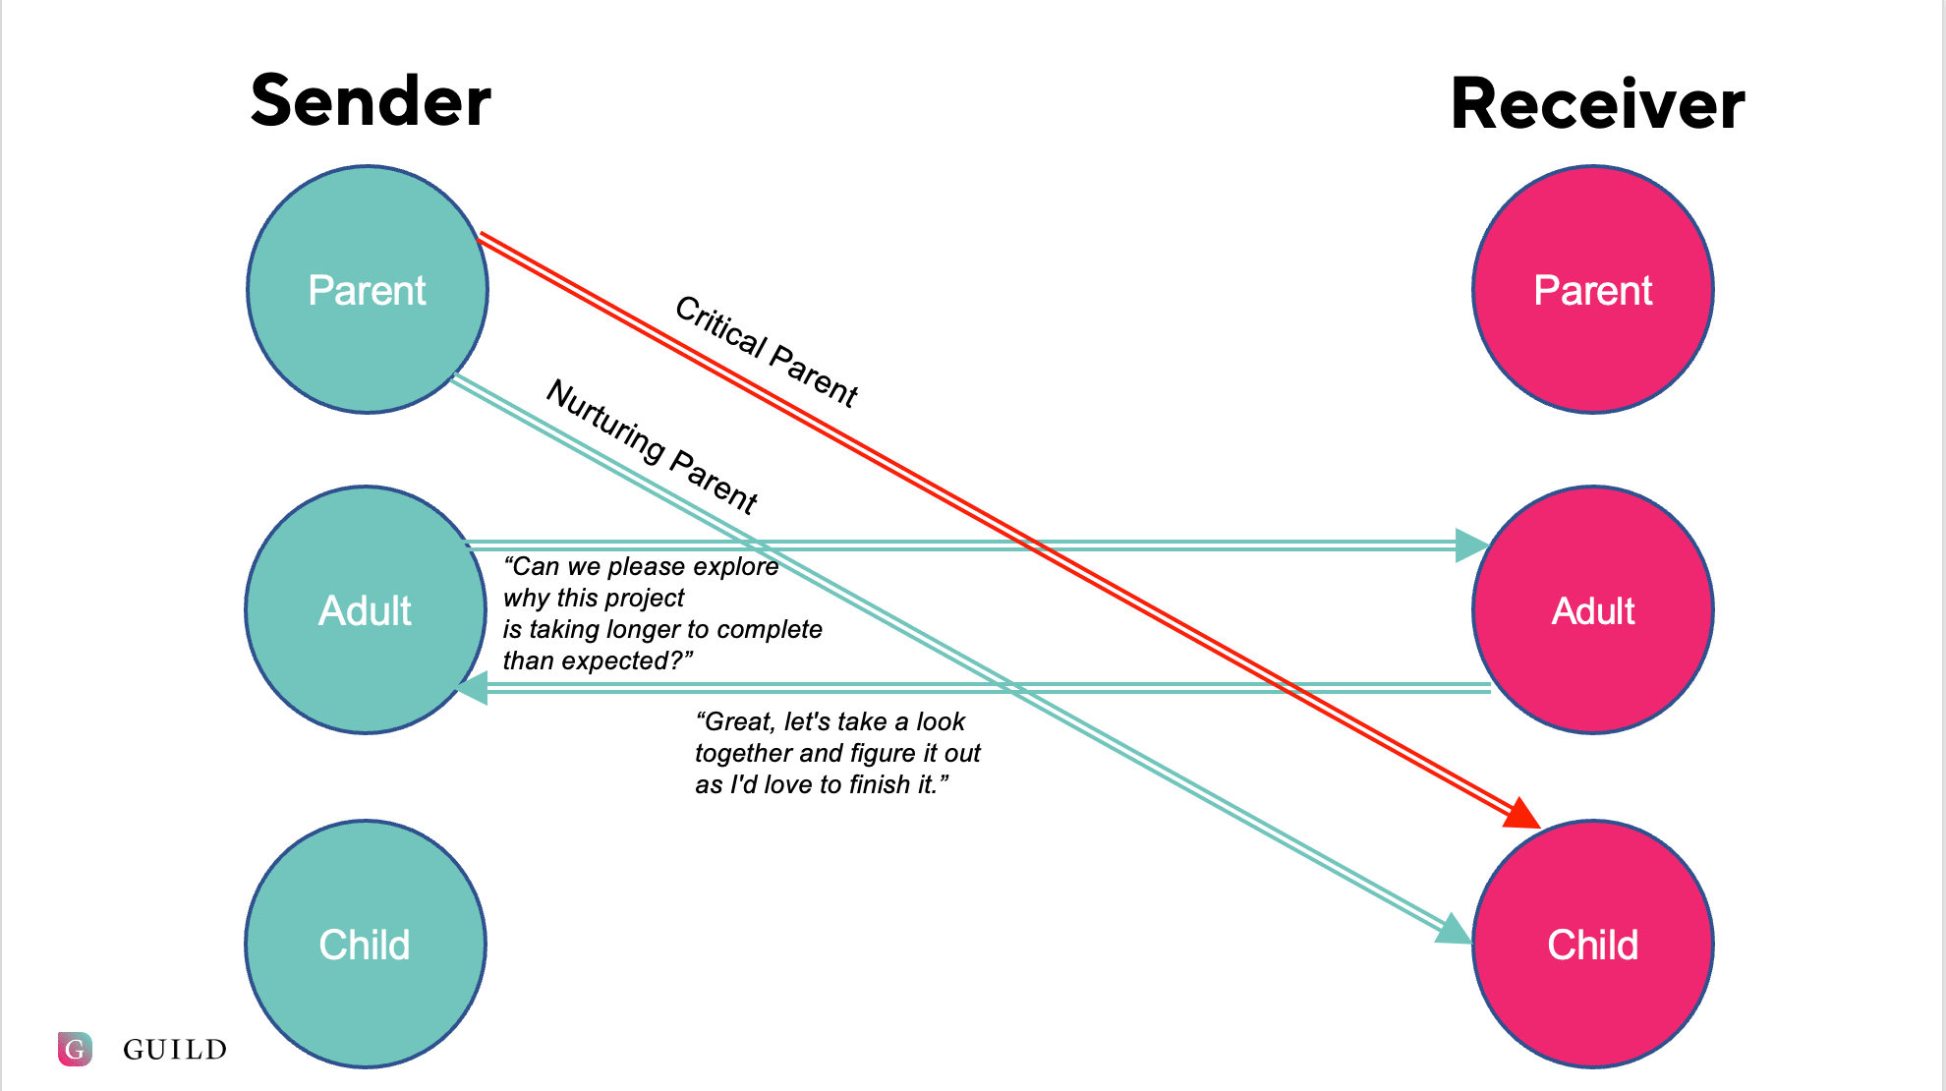

Slide 20
P.I.U.S
Positive
Say it in a positive way and say what you want as opposed to what you don't want
I Statement
Start with an 'I' statement and express a feeling
Understanding
Offer an understanding statement
Share
Share the responsibility or offer to help
The acronym P.I.U.S. can be used to help remember how to get our communication back on track

Slide 21
‘YOU’ Statements
You and your friends made a mess of this place.
You’re no fun to be with when you’ve been drinking.
Don’t shout at the kids like that.
I can’t stand it when you lie to me.
You never listen to me when I talk to you.
How could you do this?
You took money from me without asking?
If I am going to the trouble of cooking for you the least, you could do is turn up on time.
You’re a disgusting slob
What are you thinking using drugs in front of the kids?

Slide 22
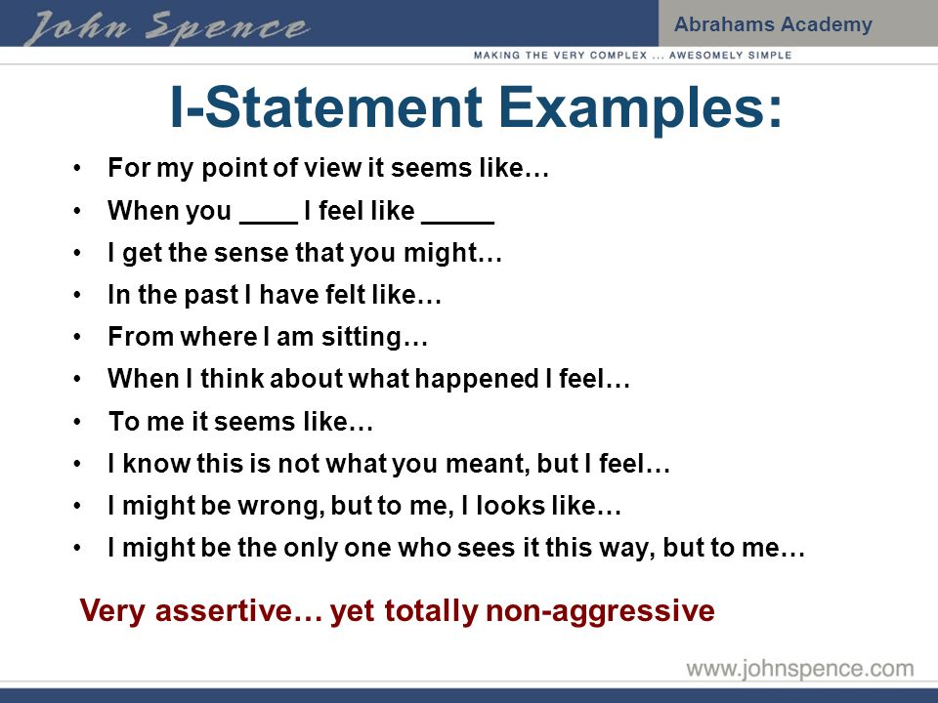
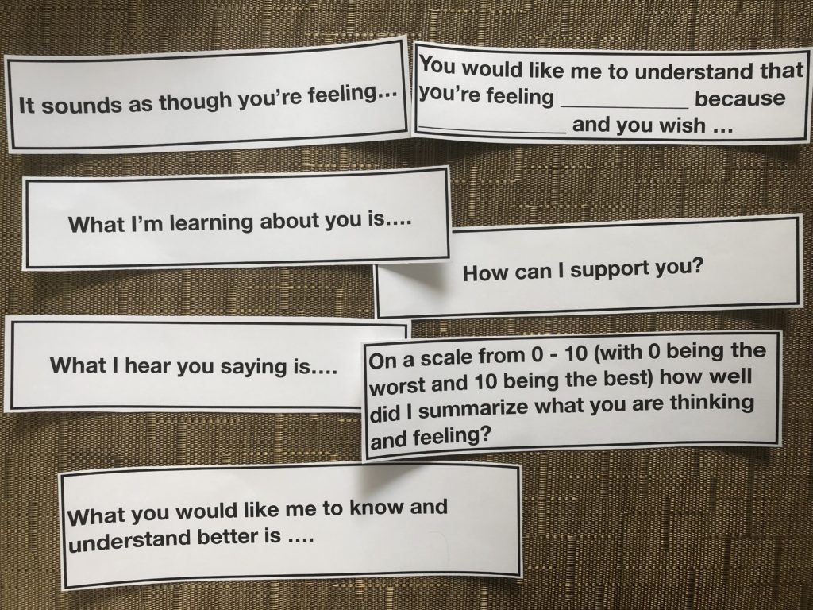
' I ' Statements
Source: www.johnspence.com

Slide 23
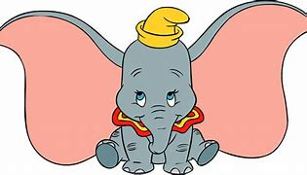
Reflective Listening
Reflective listening turns down the volume on everyone's anger, builds trust and mends fences.
You don't comment on what your LO has just said, you don't point out ways in which you think your LO is wrong, you don't judge or react in any way.
Really listen and don't react.
Reflect back what you 'understand' was said and what you heard, in your own words.

Slide 24
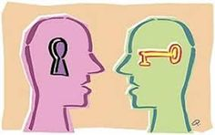
Going Forward in Communication
Plan ahead
Be positive
Use “I” Statements
Be understanding
Accept and share responsibility
Listen in order to disarm
Empathise in order to befriend

Slide 25

Boundaries
We may never think about them UNTIL the relationship becomes unhealthy or experiences problems.
What are Boundaries ?
basis for mutual respect between two parties
guidelines, rules, or limits
not brick walls
Healthy boundaries are not “about the other” person or their actions. They are “about the self”.

Slide 26
Healthy Boundaries
Boundaries are the guidelines that we identify to define what we feel are reasona­ble, safe and permissible ways for other people to behave around us and to treat us.
Initially, it may be easy to shy away from the topic of boundaries, especially if we think of boundaries as restrictive walls that close us in and shut others out.
A more helpful way to think of boundaries is to think about the true function they serve.
Clear boundaries can minimise miscommunication and free us to enjoy a healthier relationship with our Loved One (LO)

Slide 27
Whose Boundaries Crossed ?
I loan money to my Loved One (LO), but often do not get repaid
I am supporting someone financially who should be able to support him/herself
My LO lies to me, covers up the truth of their activities
I fail to speak up when I am being treated poorly
I frequently agree to do things in order to keep the peace, or to please others
I give and give and give in this relationship, and in return, I get less and less and less
My LO sometimes disappears for long periods of time without making contact
I frequently feel angry in response to my LO’s behaviours
I feel like I can’t make plans, because my LO is so unpredictable
Your boundaries may be being crossed by another

Slide 28
You May Be Crossing your Own Boundaries
I don’t give any thought to my own happiness
I can only be happy if my LO is doing well otherwise, I’m anxious
I don’t feel like I’m thriving, only surviving
I feel hurt and resentful a lot of the time
I feel like I'm trying to keep the peace all the time
You may be crossing your own
boundaries

Slide 29
How to Implement Boundaries
Inform: When you do: (YOUR BEHAVIOUR) I feel: (MY REACTION)
“When you don’t let me know where you are, I feel very worried about you. I would like it in the future if you could call and tell me you are going to be late”
Request: Can I ask you to (STOP or CHANGE this BEHAVIOUR?)
“When you have the TV turned up loud I feel frustrated because I can’t hear the baby monitor. Can I ask you to turn down the volume, please?”

Slide 30

Boundaries
What if there still crossed?
Do not punish!! It almost always never works
Disengagement is the key
  Inform; 'when you raise your voice, it hurts me and it
  scares the kids'
  Request; 'I've asked you several times over the last few
  weeks to speak in a normal volume, but nothing has
  changed.'
  Inform; 'from now on, when you raise your voice, the kids and I will stay the night at Grans'
  Calm, Clear & Consistent
  Remember, boundaries are a two way street!

Slide 31
SMART Friends and Family
Check out
How have you found the session?
Any concerns for the coming week?
What will you focus on this week?
Anything else we can help with?

Slide 32

SMART Friends and Family
Tool time

Slide 33
GYLOS/CRAFT/SMAT F&F – Key Insights
We are trying to do two things;
Make ourselves feel better
Encourage our LO’s into treatment, by changing the way we react to them. Reinforcing non using behaviour, detaching from using behaviour
Think about the last argument you had with your LO
Write it out, like you were writing a scene from a play, capture every nuance of the interaction
Where could you have made changes in your behaviour to:
Disable the enabling
Employ PIUS (your LO is loved, but his behaviour isn’t)
Maintain/set boundaries
We hear, across the world, over and over again, from recovered individuals that it was the boundaries that their significant others set & maintained that helped them into recovery
BUT – they didn’t like it at first!

Slide 34
Compassion vs Judgement
Are we judging our loved one, using old stereotypes of our understanding of addiction?
They’re weak, they have no backbone, why don’t they just stop it?
How would we view them if they had cancer?
Our loved ones ARE NOT doing this to us or to punish us!
Our loved ones feel guilt, don’t exacerbate that guilt by judging as it feeds the addiction
Pain vs Suffering
We can’t make the pain of having someone in addiction go away, BUT we can end the suffering.
The suffering is a result of how we are thinking about our loved one.
Are we angry with our loved one?
Basis for anger is FEAR

Slide 35
False
Evidence
Appearing
Real
Often we put off making difficult choices out of FEAR.
FEAR of what might happen as a result of our choice. This fear can keep us stuck, unwilling to make a change because we cannot guarantee the outcome of our choices. We become immobilised, effectively afraid of an outcome which has not yet happened and which may not ever happen
Resolving FEAR exercise
Divide a sheet of paper into three columns
Column 1: What scares me? Name your fear or feared negative outcome (e.g. I’m afraid if I leave, they’ll just get worse)
Column 2: Write the fear as a ‘what if’ sentence. What if that happens? (e.g. What if I leave and they do get worse?)
Column 3: What would I do in response?

Slide 36
Check in with yourself to see if actually confronting the fear and making a plan reduces the anxiety associated with it.
If it leads to another fear such as feeling guilty then make that the next fear in the first column and continue
Example:
I’m afraid they’ll get worse and I’ll feel guilty
What if I do feel guilty?
What would I do?
Keet going with this until you have a plan. This technique allows us to create plans for these feared outcomes (which may never come to pass). This gives us more control over them and reduces our worry about them. It takes away the mystery and allows us to reassure ourselves that if the feared outcome did occur, we would be able to handle it.
NOTE this exercise can be used for any source of anxiety, not just anxiety related to making a difficult choice.

Slide 37
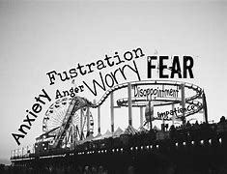
Change and Motivation
The addictive behaviour of someone you are close to can have an enormous impact on your emotional and physical well-being. It can be like living on a roller coaster, putting huge pressure and stress on your ability to cope. If you have 'tried everything' and nothing is working, you may have already decided that it's time for something to change.
Whether you are looking to support a LO toward a positive lifestyle change, or looking to restore some balance to your own life, or whether you are looking to accomplish both, this section will help you to understand how we change and why we change.

Slide 38

Why Should I Change?
You have probably tried lots of different ways to manage the situation and help your Loved One (LO). Some examples of the unhelpful coping strategies we are referring to include:
Keeping your LO's behaviour a secret
Covering for or 'protecting' your LO
Becoming a nurse
Being controlling
Supplying your LO to 'keep them safe'
Nagging and Pleading
Trying harder to be a better parent, partner,
friend
Obsessing over the addictive behaviour
'Rescuing' your LO

Slide 39
Change: Are Your Coping and Helping Behaviours Working?
List some examples of things you have tried to get your LO to stop using/ doing their DOC (drug/ destruction of choice).
Let’s reflect on what has and hasn't worked.
WORKED | DID NOT WORK
The only person whose behaviour you can control is you

Slide 40
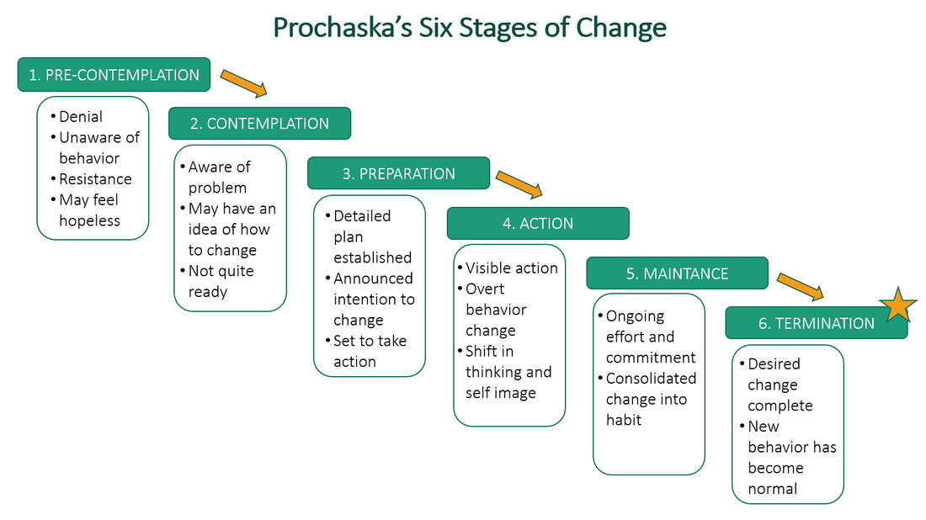
The Stages of Change
Change is a process, not an event. It usually doesn't happen overnight.

Slide 41
The Stages of Change
The Stages of Change
Pre-Contemplation
(Start)
Current Behaviour
Contemplation
Relapse
(Optional)
Recycling
Preparation
Maintenance
Action
Graduation
(New Positive Behaviour)
Change is a process, not an event. It usually doesn't happen overnight.

Slide 42
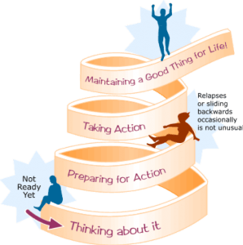
The Stages of Change
1. Contemplation: Thinking About It
2. Preparation: Preparing for Action
3. Action: Taking Action
4. Maintenance: Maintaining a Good Thing for Life
Change is a process, not an event. It usually doesn't happen overnight.

Slide 43
Change: Cost Benefit Analysis (CBA)
List a way that you currently respond to your LO (yelling, avoiding, nagging).
List an alternative way that you could respond to your LO. How can you change your behaviour?
Make it specific.
Label each behaviour as either short term (ST) or long term (LT).
Continuing the Behaviour
Advantages (benefits & rewards) | Disadvantages (costs & risks)
Ceasing the Behaviour
Advantages (benefits & rewards) | Disadvantages (costs & risks)

Slide 44
Change Plan Worksheet
Planning is key to making successful changes.
Use this worksheet to develop your own plan for making a change in your behaviour.
The Change I want to make is: How confident am I that I can make these changes?
2. The most important reasons why I want to make this change are:
3. The steps I plan to take in changing are:
4. The ways other people can help are:
5. I will know that my plan is working if:
6. Some things that could interfere with my plan are:
7. How important is it that I make this change ?

Slide 45
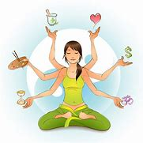
Self-Care & Self-Rewards
Addiction has a way of quickly throwing lives out of balance. Ask yourself the following questions:
Are you obsessing over your LO's addiction and feeling confused and helpless ?
Are you finding it had to get anything done ?
Are you having difficulty staying focused on anything else in your life ?
Are you reluctant to make plans to do anything, because you never know when 'the other shoe is going to drop' ?

Slide 46
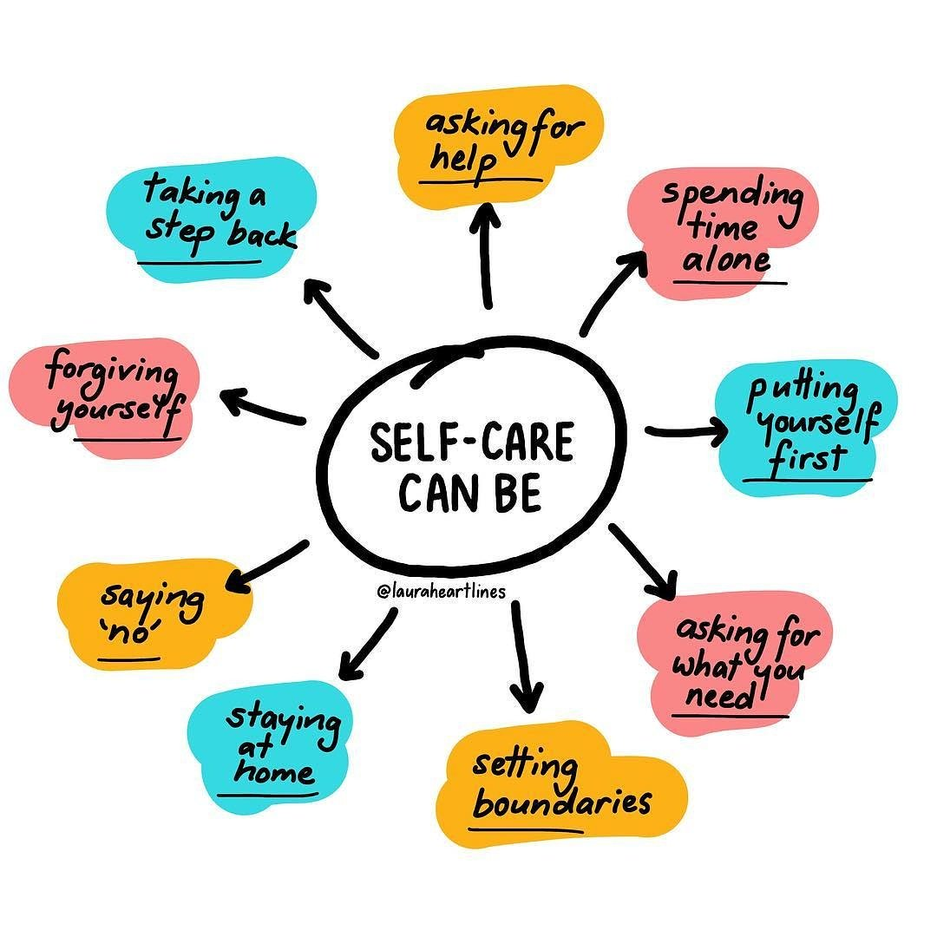
Self Care....can be

Slide 47
Self-Care Examples
Tired = Nap
Sad = Music
Stressed = Walk
Angry = Exercise
Burnt Out = Read
Feeling Lost = Journal
Anxious = Meditate
Overthinking = Write
Uninspired = Cut Screen Time

Slide 48
The Importance of Self Care
Incorporate self-care into your life by:
Make daily self-care a top priority
Look after your health, your fitness and your appearance
Actively plan for incorporating more fun into your life
Create a social circle
Find a confidante
Plan ahead for self-rewards and activities
Being close to someone who has an addictive behaviour can be very stressful.
You may respond to the stress by doing more and more to try to fix the situation, often at the expense of your own needs.
Unfortunately, this can lead to you becoming run down and exhausted.

Slide 49
Self Care: 3 Column Technique
Practical
(Self-Maintenance)
These are the things you do to maintain yourself
Purposeful
(Self-Development)
These are the activities you do to educate or challenge yourself
Pleasurable
(Fun)
These are the activities you do to relax and enjoy yourself with friends and family
SMART UK Handbook. Edition Feb 2015 – Page 71

Slide 50
Self Care: 3 Column Technique
Practical
(Self-Maintenance)
These are the things you do to maintain yourself
Job
Personal Admin
Shopping
Paying Bills
Cleaning
Looking after Kids
Purposeful
(Self-Development)
These are the activities you do to educate or challenge yourself
Learn a Language
Take Evening classes
Read Self-Help books
Learn to draw
Join a gym/train for a marathon
Train for a Marathon
Train as a Facilitator
Pleasurable
(Fun)
These are the activities you do to relax and enjoy yourself with friends and family
Games/Movie night
Ride a horse
Play an instrument
Play Sports
Baking
Learn to Dance
Archery
Build something (Lego)
SMART UK Handbook. Edition Feb 2015 – Page 71

Slide 51
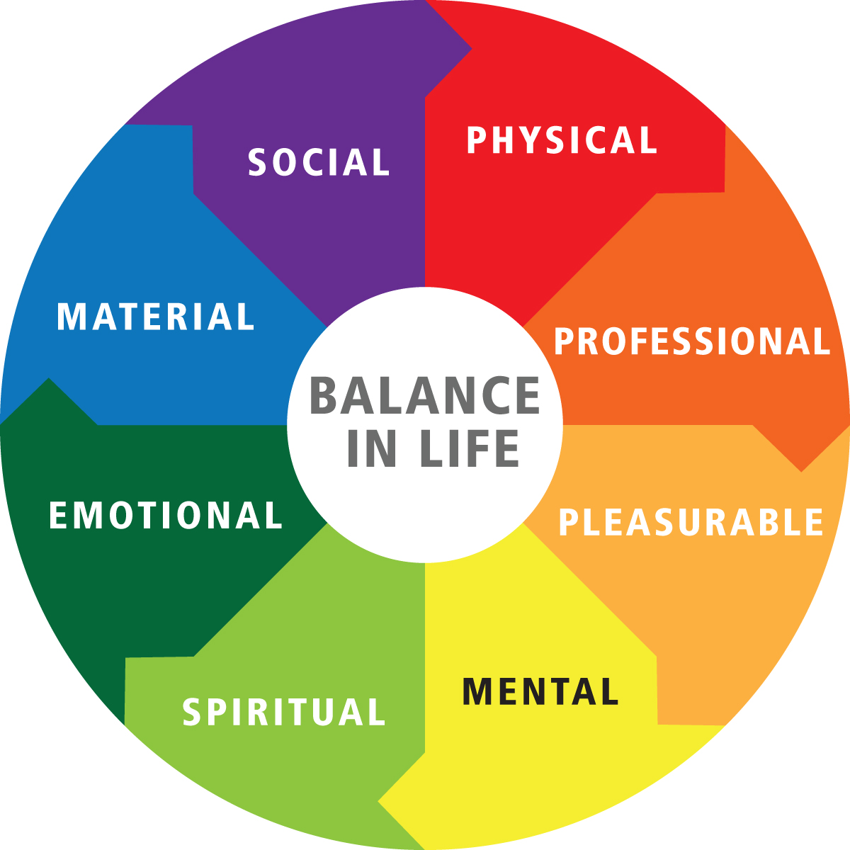
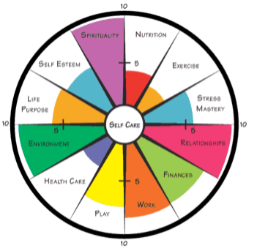
Self Care: Lifestyle Balance Pie
A balanced lifestyle is simply a state of being in which one has time and energy for obligations and pleasures, as well as time to live well and in a gratifying way.
Create a list of important activities in your life.
Rate on a Scale of 1 – 10 the amount of time you spend on each activity. Are all of your activities in balance with each other?

Slide 52
Self Care: Lifestyle Audit
A balanced lifestyle is simply a state of being in which one has time and energy for obligations and pleasures, as well as time to live well and in a gratifying way.
Create a list of enjoyable Activities.
Think about: Social, Fun, Educational & Relaxing
Things I would like to do LESS of | How I could do this LESS
Things I would like to do MORE of | How I could do this MORE

Slide 53
Self-Care Relaxation Exercise
Thighs, Calves, Ankles & Feet
Head
Tighten Your Thigh Muscles, trying not to involve Abdominal Muscles
Tense the Calf Muscles
Point your Toes out Directly in front of you, feeling the Tension in your Ankles
Curl your Toes under, as if to Touch the Bottom of your Feet
Bring your Toes up as if to Touch your Knees
Wrinkle Your Forehead
Screw Your Eyes Tightly
Open Your Mouth Wide
Push Your Tongue Against the Roof of your Open Mouth
Clench Your Jaw Tightly

Slide 54
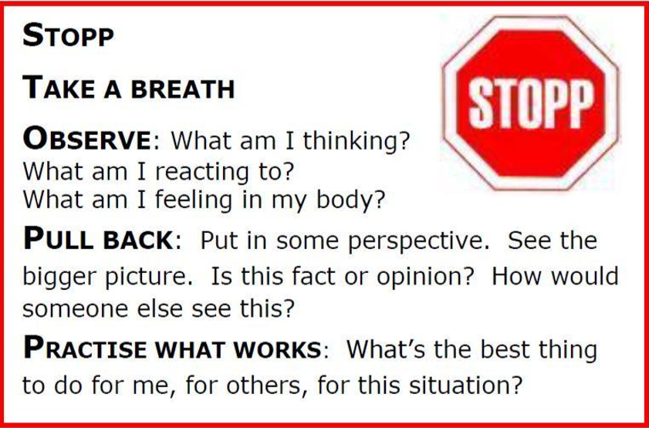
Self-Care Relaxation Exercise
Source: http://www.getselfhelp.co.uk/stopp.htm

Slide 55
Self Care: Personal Bill of Rights
I have the right to ask for what I want.
2. I have the right to say no to requests or demands I cannot meet.
3. I have the right to express all of my feelings, positive or negative.
4. I have the right to change my mind.
5. I have the right to make mistakes and not have to be perfect.
6. I have the right to follow my own values and standards.
7. I have the right to say no to anything when I feel I am not ready, it is unsafe, or it violates my values.
8. I have the right to determine my own priorities.
9. I have the right not to be responsible for others' behaviours, actions, feelings, or problems.
10. I have the right to expect honesty from others.

Slide 56
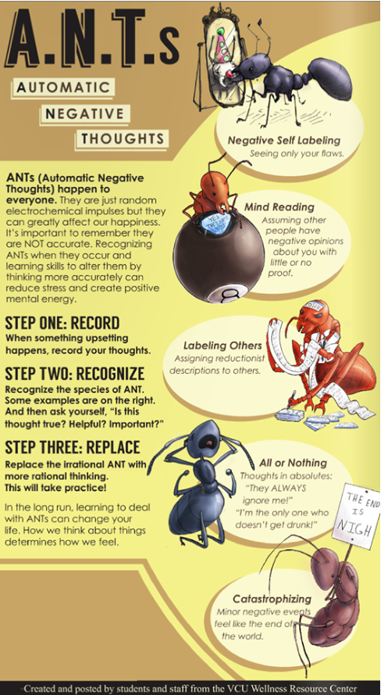
DiB’s
Automatic
Negative
Thoughts

Slide 57
DiB’s: Cognitive Distortions
Jammed
J - Jumping to conclusions
A - All or nothing thinking
M - Mental filter
M – Maximizing / . Minimizing
E - Emotional reasoning
D - Downplaying the . positive
SLOP
S - Should statements
L - Labeling
O - Overgeneralization
P - Personalization
with
Notes:
https://www.smartrecovery.org/smart-articles/cognitive-distortions/ http://www.smartrecovery.org/community/showthread.php?t=11787#.VCXKkJ0o6YM (Arby’s)
JUMPING TO CONCLUSIONS: You make a negative interpretation even though there are no definite facts that convincingly support your conclusion.
a. Mind reading. You arbitrarily conclude that someone is reacting negatively to you, and you don’t bother to check this out.
b. The Fortune Teller Error. You anticipate that things will turn out badly, and you feel convinced that your prediction is an already-established fact.
ALL-OR-NOTHING THINKING: You see things in black-and- white categories. If your performance falls short of perfect, you see yourself as a total failure
MENTAL FILTER: You pick out a single negative detail and dwell on it exclusively so that your vision of all reality become darkened, like the drop of ink that discolors the entire beaker of water.
MAGNIFICATION (CATASTROPHIZING) OR MINIMIZATION: You exaggerate the importance of things (such as your goof-up of someone else’s achievement), of you inappropriately shrink things until they appear tiny (your own desirable qualities or the other fellows imperfections). This is also called the “binocular trick.”
EMOTIONAL REASONING: You assume that your negative emotions necessarily reflect the way things really are: “I feel it, therefore it must be true.”
DISQUALIFYING THE POSITIVE: You reject positive experiences by insisting they “don’t count” for some reason or other. In this way you can maintain a negative belief that is contradicted by your everyday experiences.
SHOULD STATEMENTS: You try to motivate yourself with shoulds and shouldn’ts, as if you had to be whipped and punished before you could be expected to do anything. “Musts” and “oughts” are also offenders. The emotional consequence is guilt. When you direct should statements toward others you feel anger, frustration, and resentment.
LABELING AND MISLABELING: This is an extreme form of overgeneralization. Instead of describing your error, you attach a negative label to yourself: “I’m a loser.” When someone else’s behaviour rubs you the wrong way, YOU attach a negative label to him: “He’s a goddamn louse.” Mislabelling involves describing an event with language that is highly coloured and emotionally loaded.
OVERGENERALIZATION: You see a single negative event as a never-ending pattern of defeat.
PERSONALIZATION: You see yourself as the cause of some negative external event which in fact you were not primarily responsible for.

Slide 58
DiB’s: Cognitive Distortions
Jammed
J - Jumping to conclusions
You interpret things negatively when there are no facts to support your conclusion.
Mind reading: Without checking it out, you arbitrarily conclude that someone is reacting negatively to you.
Fortune telling: You predict that things will turn out badly.
A - All or nothing thinking
You see things in black and white categories If a situation falls short of perfect, you see it as a total failure.
M -Mental filter You pick out a single negative detail and dwell on it exclusively. Example: You receive many positive comments about your presentation to a group of associates at work, but one of them says something mildly critical. You obsess about this for days and ignore all the positive feedback.
M -Maximizing / Minimizing You exaggerate the importance of your problems and shortcomings, or you minimize the importance of your desirable qualities. This is also called the ‘binocular trick.’
E - Emotional reasoning You assume that your negative emotions necessarily reflect the way things really are: “I feel it, therefore it must be true.” You assume that your negative emotions necessarily reflect the way things really are: ‘I feel terrified about going on airplanes. ‘It must be very dangerous to fly.’ Or ‘I feel guilty. I must be a rotten person.’
D - Downplaying the Positive.
You reject positive experiences by insisting they ‘don’t count.’ Discounting the positive takes the joy out of life and makes you feel inadequate and unrewarded.
Notes:
https://www.smartrecovery.org/smart-articles/cognitive-distortions/ http://www.smartrecovery.org/community/showthread.php?t=11787#.VCXKkJ0o6YM (Arby’s)
JUMPING TO CONCLUSIONS: You make a negative interpretation even though there are no definite facts that convincingly support your conclusion.
a. Mind reading. You arbitrarily conclude that someone is reacting negatively to you, and you don’t bother to check this out.
b. The Fortune Teller Error. You anticipate that things will turn out badly, and you feel convinced that your prediction is an already-established fact.
ALL-OR-NOTHING THINKING: You see things in black-and- white categories. If your performance falls short of perfect, you see yourself as a total failure
MENTAL FILTER: You pick out a single negative detail and dwell on it exclusively so that your vision of all reality become darkened, like the drop of ink that discolors the entire beaker of water.
MAGNIFICATION (CATASTROPHIZING) OR MINIMIZATION: You exaggerate the importance of things (such as your goof-up of someone else’s achievement), of you inappropriately shrink things until they appear tiny (your own desirable qualities or the other fellows imperfections). This is also called the “binocular trick.”
EMOTIONAL REASONING: You assume that your negative emotions necessarily reflect the way things really are: “I feel it, therefore it must be true.”
DISQUALIFYING THE POSITIVE: You reject positive experiences by insisting they “don’t count” for some reason or other. In this way you can maintain a negative belief that is contradicted by your everyday experiences.
SHOULD STATEMENTS: You try to motivate yourself with shoulds and shouldn’ts, as if you had to be whipped and punished before you could be expected to do anything. “Musts” and “oughts” are also offenders. The emotional consequence is guilt. When you direct should statements toward others you feel anger, frustration, and resentment.
LABELING AND MISLABELING: This is an extreme form of overgeneralization. Instead of describing your error, you attach a negative label to yourself: “I’m a loser.” When someone else’s behaviour rubs you the wrong way, YOU attach a negative label to him: “He’s a goddamn louse.” Mislabelling involves describing an event with language that is highly coloured and emotionally loaded.
OVERGENERALIZATION: You see a single negative event as a never-ending pattern of defeat.
PERSONALIZATION: You see yourself as the cause of some negative external event which in fact you were not primarily responsible for.

Slide 59
DiB’s: Cognitive Distortions
SLOP
S -Should statements
You try to motivate yourself with shoulds and shouldn’ts, as if you had to be whipped and punished before you could be expected to do anything. “Musts” and “oughts” are also offenders. The emotional consequence is guilt. When you direct should statements toward others you feel anger, frustration, and resentment.
L – Labelling
Labelling is an extreme form of all-or-nothing thinking. Instead of saying ‘I made a mistake.’ you attach a negative label to yourself: ‘I’m a loser.’ You might also label yourself ‘a fool’ or ‘a failure’ or ‘a jerk. 'These labels are useless abstractions that lead to anger, anxiety, frustration, and low self- esteem.
You may also label others. ‘He’s an ****’. Then you feel that the problem is with that person’s ‘character’ or ‘essence’ instead of with their thinking or behaviour. You see them as totally bad. This makes you feel hostile and hopeless about improving things and leaves little room for constructive communication.
O- Overgeneralization
You see a single negative event as a never-ending pattern of defeat by using words such as ‘always’ or “never” when you think about it.
P – Personalization
Personalization occurs when you hold yourself personally responsible for an event that isn’t entirely under your control.
Notes:
https://www.smartrecovery.org/smart-articles/cognitive-distortions/ http://www.smartrecovery.org/community/showthread.php?t=11787#.VCXKkJ0o6YM (Arby’s)
JUMPING TO CONCLUSIONS: You make a negative interpretation even though there are no definite facts that convincingly support your conclusion.
a. Mind reading. You arbitrarily conclude that someone is reacting negatively to you, and you don’t bother to check this out.
b. The Fortune Teller Error. You anticipate that things will turn out badly, and you feel convinced that your prediction is an already-established fact.
ALL-OR-NOTHING THINKING: You see things in black-and- white categories. If your performance falls short of perfect, you see yourself as a total failure
MENTAL FILTER: You pick out a single negative detail and dwell on it exclusively so that your vision of all reality become darkened, like the drop of ink that discolors the entire beaker of water.
MAGNIFICATION (CATASTROPHIZING) OR MINIMIZATION: You exaggerate the importance of things (such as your goof-up of someone else’s achievement), of you inappropriately shrink things until they appear tiny (your own desirable qualities or the other fellows imperfections). This is also called the “binocular trick.”
EMOTIONAL REASONING: You assume that your negative emotions necessarily reflect the way things really are: “I feel it, therefore it must be true.”
DISQUALIFYING THE POSITIVE: You reject positive experiences by insisting they “don’t count” for some reason or other. In this way you can maintain a negative belief that is contradicted by your everyday experiences.
SHOULD STATEMENTS: You try to motivate yourself with shoulds and shouldn’ts, as if you had to be whipped and punished before you could be expected to do anything. “Musts” and “oughts” are also offenders. The emotional consequence is guilt. When you direct should statements toward others you feel anger, frustration, and resentment.
LABELING AND MISLABELING: This is an extreme form of overgeneralization. Instead of describing your error, you attach a negative label to yourself: “I’m a loser.” When someone else’s behaviour rubs you the wrong way, YOU attach a negative label to him: “He’s a goddamn louse.” Mislabelling involves describing an event with language that is highly coloured and emotionally loaded.
OVERGENERALIZATION: You see a single negative event as a never-ending pattern of defeat.
PERSONALIZATION: You see yourself as the cause of some negative external event which in fact you were not primarily responsible for.

Slide 60
DiB’s: Inner Dialogue
The book 'Get Your Loved One Sober: Alternatives to Nagging, Pleading and Threatening' is based on the scientifically validated CRAFT (Community Reinforcement and Family Therapy) model.
GYLOS advises Family & Friends to remain calm, avoid losing their temper and avoid catastrophising (or 'awfulising') situations in order to interact with their LO's in a non-confrontational way.
This can be quite challenging for Family & Friends who have developed habitual patterns of thinking and interacting with their LO that get in the way of calm and non-confrontational conversation.

Slide 61
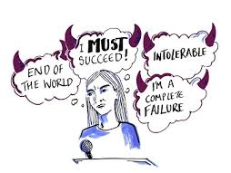
DiB’s: What are Self-Defeating Beliefs?
Self-Defeating Beliefs:
distort reality
misinterpret what is happening
involves some illogical way of evaluating yourself, others, and the world around you
also known as irrational beliefs

Slide 62
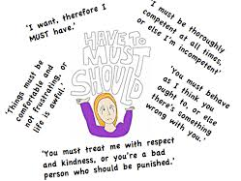
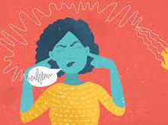
DiB’s: Self-Defeating Beliefs Examples
Awfulising: using words like awful, terrible, horrible, catastrophic to describe something
It would be terrible if..
It’s the worst thing that could happen…
That would be the end of the world…
Can’t Stand It: viewing an event or experience as unbearable
I can't stand it
It’s absolutely unbearable
I’ll die if I get rejected

Slide 63
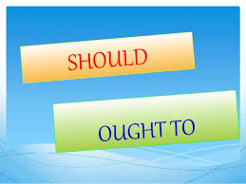
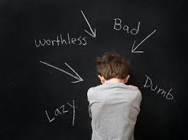
DiB’s: Self-Defeating Beliefs Examples
Demanding: Using should (moralising) or musts
I should not have done that
I must not fail
I need to be loved
I have to have FIX this
Labelling: People-rating labelling or rating your total self or someone else's
I'm stupid, hopeless, useless, worthless

Slide 64
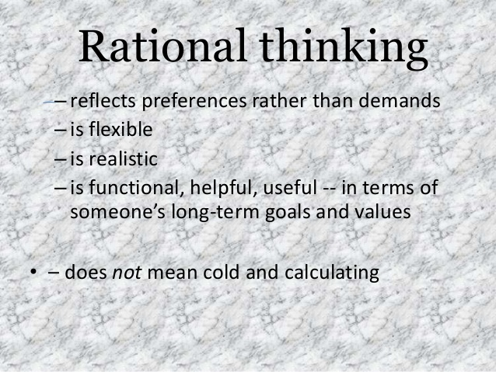
DiB’s: What is Rational Beliefs?
Rational Beliefs are:
  based on reality
  logical thinking
  most likely to lead us to the truth and knowledge
Three questions to ask to determine if a belief is rational or self-defeating:
  True – it’s realistic and there is evidence to support it
  Makes Sense – it is logistical
  Helpful – it helps you get want you want in the long run

Slide 65
DiB’s: Rational Beliefs Examples
Love and approval are good things to have, and I'll seek them when I can. But I can survive (even though it's uncomfortable) without them
It's unfortunate that people sometimes do bad things. But humans are not perfect – and upsetting myself won't change that reality
There is no law which says that things have to be the way I want. I can stand it – especially if I avoid catastrophising
Many external factors are outside my control. But it is my thoughts and beliefs which cause my feelings
Relying on someone else can lead to dependent behaviour. It is OK to seek help – as long as I learn to trust myself and my own judgements
I can't change other people's problems and bad feelings by getting myself upset. But I can acknowledge that other people have a right to their own thoughts, feelings and behaviours

Slide 66
DiB’s: Exchange Vocabulary
An unhealthy negative emotion is unhealthy because it leads to self-defeating behaviours: aggression, problem avoidance.
A healthy negative emotion is healthy because it leads to self-enhancing behaviours: assertiveness, approaching problems, wanting to tackle problems, try new things.
Word Exchange
Statement Exchange
Emotional Exchange
Instead of Thinking: | Try Thinking:
Must | Prefer
Should | Choose To
Have To | Want
Can’t | Choose Not To
Ought | Had Better
All | Many
Always | Often
Can’t Stand | Don’t Like
Awful | Highly Undesirable
Instead of Saying: | Exchange With:
I have to do well. | I want to do well.
You shouldn’t do that. | I prefer you not do that.
You never help me. | You rarely help me.
I’m a loser. | I failed at this one task.
I need love. | I want love, but don’t need it.
Instead of Saying: | Exchange With:
Anxious | Concerned
Depressed | Sad
Angry | Annoyed
Guilt | Remorse
Shame | Regret
Hurt | Disappointed
Jealous | Concern for my relationship

Slide 67
DiB’s: Exchange Vocabulary
Remember to “THINK” before you speak
T = True
H = Helpful
I = Important
N = Necessary
K = Kind

Slide 68
DiB’s: Resisting Invitations to Guilt & Self Blame
It is common for people in a close relationship to someone with a drug and/or alcohol dependency to blame themselves and feel guilty about their LO's behaviour.
Beating yourself up about any mistakes you have made and taking on the blame for another's self-destructive behaviour can have the following effects:
Leave you feeling stuck and helpless
Lead you to putting up with behaviour that is not acceptable
Encourage you to become overly responsible for your LO
Leave you open to being manipulated by your LO
Leave you open to getting sick yourself

Slide 69
DiB’s: Ideas for Letting go of Guilt & Self Blame
Ask yourself: Is it really my fault?
Remind yourself that no one is perfect
Think about all the other influences on your LO's life that is outside of your control
Remind yourself that you are also a product of your own set of circumstances and influences
Try to view yourself with compassion, rather than judgement
Remind yourself that continuing to feel guilt and self-blame does not help and may make it worse
If appropriate, make amends for any hurt you might have caused in the past
Notice what words you use to talk to yourself

Slide 70
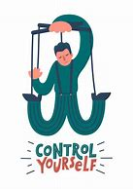
DiB’s: Who Controls You ?
As you think, so you feel.........
Events and circumstances do not cause your reactions. They result from what you tell yourself about the things that happen.
Put simply, thoughts cause feelings and behaviours.
The past is significant. But only in so far as it leaves you with your current attitudes and beliefs.
The cause is not the event – it's what you tell yourself about the event.
Let us look at ABC's of feelings & behaviours.........

Slide 71
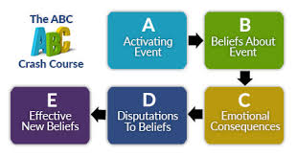
DiB’s: The ABC Crash Course
The Rules We Live By:
What we tell ourselves in specific situations depends on the rules we hold.
Everyone has a set of general 'rules'. Some will be rational; others will be self-defeating or irrational.
Each person's set is different.
Mostly subconscious, these rules determine how we react to life.

Slide 72
DiB’s: ABC - The Basics
A – Activating event: describe what happened
B – Beliefs: identify your thoughts/ feelings. What beliefs do I hold about the events that have taken place?
C – Consequences: state the result, include emotions and behaviours. How did I feel or behave? Was this helpful? Does it work for me?
D – Dispute: question the belief, your thoughts/ feelings. Are my beliefs about the event helpful and rational? Are they true?
E – Effect: find a more helpful belief, emotion and behaviour. Identify a new helpful or rational belief or thought I can use to replace the unhelpful belief.

Slide 73
DiB’s: The ABC Example
The Rules We Live By:
What we tell ourselves in specific situations depends on the rules we hold.
Everyone has a set of general 'rules'. Some will be rational; others will be self-defeating or irrational.
Each person's set is different.
Mostly subconscious, these rules determine how we react to life.
A. Activating Event | Friend ignored me in the street
B. Beliefs about A | He's ignoring me. He doesn't like me.
C. Consequence | Feeling hurt, confused and think I must have upset him.
D. Dispute Belief | ??????
E. Effective New Belief | ??????

Slide 74
DiB’s: Musterbation
Three Basic Musts
I must do well
Others must treat me well.
Life must be easy
These are unrealistic demands that we place on ourselves, others and the world
SMART UK Handbook. Edition Feb 2015 – Page 54
Notes:
https://www.smartrecovery.org/smart-articles/cognitive-distortions/ ‘Should statements that are directed against yourself lead to guilt and frustration. Should statements that are directed against other people or the world in general lead to anger and frustration: ‘He shouldn’t be so stubborn and argumentative’ Many people try to motivate themselves with shoulds and shouldn’ts, as if they were delinquents who had to be punished before they could be expected to do anything. ‘I shouldn’t eat that doughnut.’ This usually doesn’t work because all these shoulds and musts make you feel rebellious and you get the urge to do just the opposite. Dr. Albert Ellis has called this ‘musterbation.’ Some call it the ‘shouldy’ approach to life.

Slide 75
DiB’s: Musterbation
Dispute the Musts
Why must you win everyone’s approval?
Where is it written that other people must treat you fairly?
Just because you want something, why must you have it?
SMART UK Handbook. Edition Feb 2015 – Page 54
Notes:
https://www.smartrecovery.org/smart-articles/cognitive-distortions/ ‘Should statements that are directed against yourself lead to guilt and frustration. Should statements that are directed against other people or the world in general lead to anger and frustration: ‘He shouldn’t be so stubborn and argumentative’ Many people try to motivate themselves with shoulds and shouldn’ts, as if they were delinquents who had to be punished before they could be expected to do anything. ‘I shouldn’t eat that doughnut.’ This usually doesn’t work because all these shoulds and musts make you feel rebellious and you get the urge to do just the opposite. Dr. Albert Ellis has called this ‘musterbation.’ Some call it the ‘shouldy’ approach to life.

Slide 76
Rational Emotional Behavioural Therapy (REBT)
Do you sometimes experience extreme upsets?
Are you often frustrated, angry, sleepless, or anxious?
Do you ever feel helpless or hopeless?
Emotional self-control is a valuable life-skill to possess, and it is one that is often seriously challenged in a relationship with someone who has an addiction.
Better emotional self-management empowers us. It empowers us to change those things that we can change (including our thinking). And it empowers us to accept those things that we cannot change.
Using REBT tools, you can work to examine the role that your thoughts and beliefs play in your ability to respond to your Loved One (LO), and to other life events. You can learn to change your thoughts and beliefs in a way that can lead to improved emotional control.

Slide 77
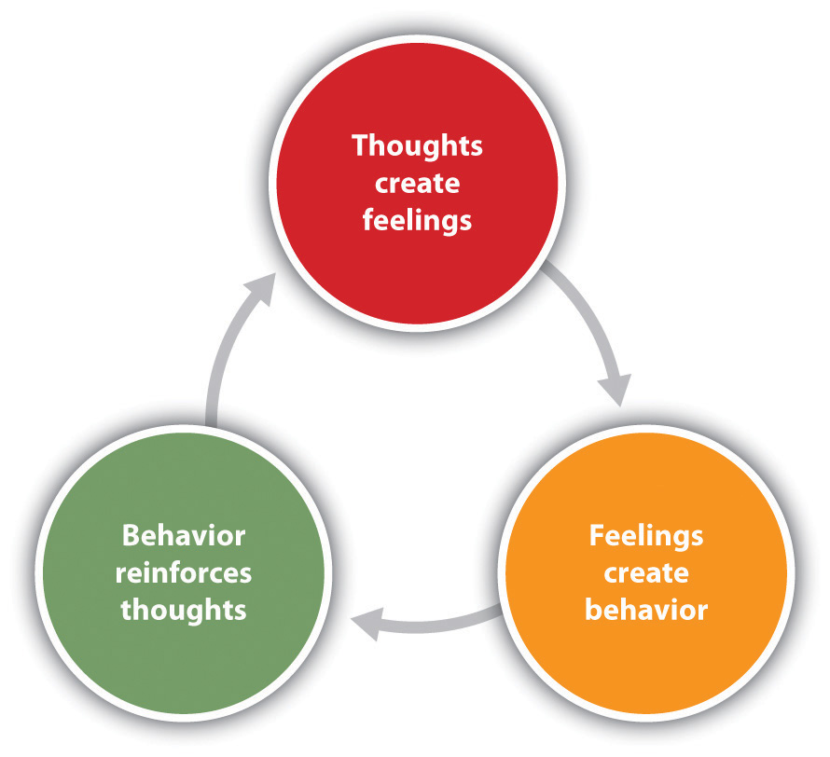
Rational Emotional Behavioural Therapy (REBT)
Cognitive Behavioural Therapy
THINK
FEEL
ACT
Our thoughts lead to
Our feelings (emotions) which determine
Our Beliefs which lead to
Our Actions.
So, if we change our thoughts…
It is not the actual events that take place in our lives that upset us, but the beliefs and expectations we hold about the events, that leads to emotional and behavioural upset.

Slide 78
REBT:Identifying & Challenging your “Beliefs”
Become aware of your thoughts, beliefs and perceptions (“catch” them)
Evaluate them – are they helpful or unhelpful (rational or irrational)?
If you judge them to be unhelpful or irrational, name them to yourself as such
Challenge or dispute iBs with a more helpful or rational thought
Ask Yourself.......
Where is holding this belief getting me? Is it helpful? Or is it self-defeating?
Where is the evidence to support my belief? Is it consistent with reality?
Is my belief rigid or flexible?
What helpful belief can I use to replace this unhelpful belief?

Slide 79
Rational Emotional Behavioural Therapy (REBT)
Let’s look at this again
REBT attributes much of the unnecessary upset or distress that we humans experience, to the unhelpful beliefs that we have learned
You can easily make yourself miserable by allowing your self-defeating or otherwise unhelpful beliefs to go unchallenged in your life
Recognising your unhelpful beliefs can be difficult, but the payoffs are big
Learning to recognise these unhelpful beliefs for what they are (beliefs that can be challenged and changed) is an important skill for emotional self-management

Slide 80
Safety and Support
What is violent behaviour?
“…violence is more than just hitting or pushing. It is also injury by distortion (as in twisting your words into something hateful) and profanation (swearing at you).
Violence is any angry, destructive force (like throwing things) as well as vehement discordance (like threatening to shut you up for good)…….Contrary to what some television shows and movies might suggest, violence is not a natural part of love or sexuality.”
Source: “Get Your Loved One Sober”

Slide 81

Safety: Examples of Physical Violence
Physical Violence
Inappropriate physical contact (e.g. hitting, choking, pushing, slapping)
Throwing objects
Locking you out of the home
Smashing, damaging, stealing or selling your possessions
Driving recklessly
Punching walls or doors

Slide 82
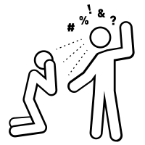
Safety: Verbal Abuse
Verbal Abuse
Humiliation/insults/shaming
Yelling/swearing/screaming
Criticising your appearance or actions
Name calling
Using a harsh and degrading tone of voice

Slide 83
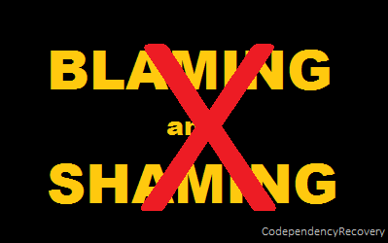
Safety: Psychological & Emotional Abuse
Humiliates you in front of others
Prevents or discourages you from seeing family or friends
Threatens to hurt you or people you care about
Threatens to harm him/herself when upset with you
Controls how you spend your money
Unfairly accuses you of being unfaithful
Put-downs, blaming you
Dismissing your feeling

Slide 84
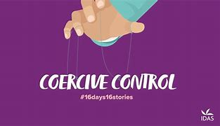
Safety:Coercive Control
Womensaid.org.uk campaigned and succeeded in making coercive control a criminal offence since 2015
Coercive control is an act or a pattern of acts of assault, threats, humiliation and intimidation or other abuse that is used to harm, punish, or frighten their victim.
Isolating you from friends and family
Depriving you of basic needs, such as food
Monitoring your time
Monitoring you via online communication tools or spyware
Taking control over aspects of your everyday life, such as where you can go, who you can see, what you can wear and when you can sleep
Depriving you access to support services, such as medical services
Repeatedly putting you down, such as saying you’re worthless
Humiliating, degrading or dehumanising you
Controlling your finances
Making threats or intimidating you

Slide 85
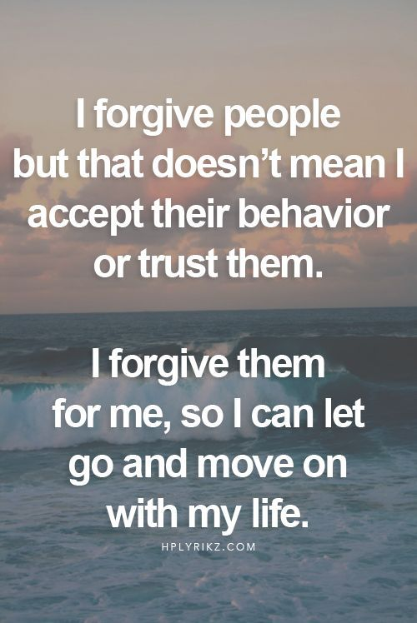
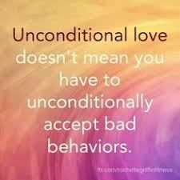
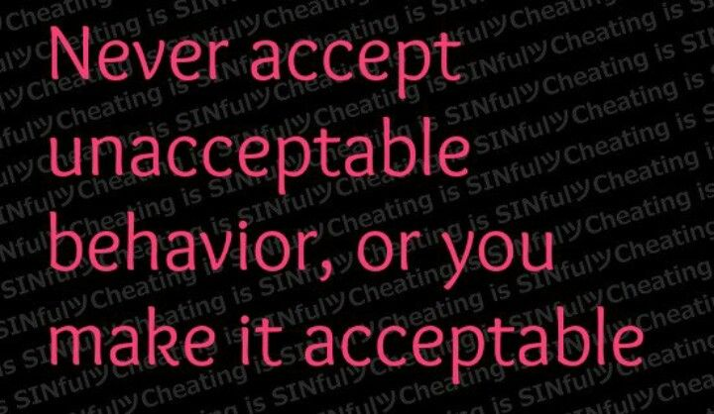
Safety: Unacceptable Behaviour

Slide 86
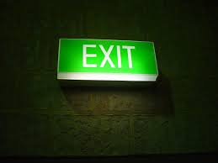
Safety: Safety Plan
Pack a bag and keep it in a safe location (not in your home)
Tell neighbours about the abuse and have them call the police if they hear noises coming from your house
Talk to your children about how they can keep themselves safe as well
Nominate a safe house – preferably not a close friend or relative’s
Psychological abuse, such as put downs, intimidation, bullying and threats, can also be harmful..
Learn to Recognise “Red Flags”: “Red Flags” are warning signs that indicate that violent behaviour may be escalating
Diffuse the situation if possible
Decide in advance at what point you need to call the police

Slide 87

Safety: Sources of Support
Call 999 if you or a child is in immediate danger – no exceptions
If it is not an emergency, contact your local policing team: www.police.uk
English National Domestic Violence Helpline 0808 2000 247 – www.nationaldomesticviolencehelpline.org.uk
Wales Domestic Abuse Helpline 0808 80 10 800 – http://www.allwaleshelpline.org.uk/
Womens Aid Federation (Northern Ireland) 0800 917 1414 – www.womensaidni.org
Scottish Women's Aid 0800 027 1234 – www.scottishwomensaid.org.uk
Men's Advice Line 0800 801 0327 – www.mensadvice.org.uk
Broken Rainbow (for lesbian, gay, bisexual and transgender people) 0300 999 5428 – www.broken-rainbow.org.uk

Slide 88
Lapses & Motivation
Implementing lifestyle changes is hard work and few people do it perfectly.
As discussed in a previous section, change is a process, not an event. Lapses and relapses are a natural part of the change process. They can occur when someone is trying to change any behaviour. Lapses and relapses often occur in the change process of someone giving up addiction...and lapses and relapses often occur when someone is making other behavioural changes (e.g., changing habitual responses to a Loved One’s addiction, such as “nagging, pleading and threatening”).

Slide 89
Lapses & Motivation
The difference between someone who gets "stuck" and finds their lapse turning into a full-blown relapse, and someone who gets back on track quickly, lies in how they interpret the lapse.
Lapses can be interpreted as failures or they can be viewed as opportunities to learn what didn't work, and to plan more effective strategies for dealing with similar circumstances in the future.
Maintaining motivation in the face of lapses and relapses is also an important component in any effective change process

Slide 90
Lapses: Maintaining Motivation
To help maintain our motivation it can be helpful to revisit our original reasons for wanting to change, review our progress so far, and our goals for the future.
Answer the following questions:
1. What were your original reasons for making changes ?
2. What changes have you noticed so far ?
3. How have these changes affected your life ?
4. What might the future look like if you continue to work towards change ?
5. Why is this important to you ?
6. What might the future look like if you stop working toward change ?
7. How do you feel about this ?
8. What will happen to keep you motivated ?

Slide 91
Trust and Forgiveness
Addictive behaviours typically include deception, false promises, broken promises and dishonest behaviours.
You may want to believe what your Loved One (LO) wants you to believe: that she/he is all right, that the addiction is not a problem, that they didn’t take money from your purse, that this time, they really are quitting.
But over time, as you uncover deceptions and experience broken promises again and again, the evidence that your LO is not entirely trustworthy may become over-whelming.
You may quite possibly find that the untrustworthy behaviours extend beyond the addiction and affect other areas of your life with your LO.

Slide 92
Trust: Important Points to Remember
You are not to blame for your LO's addiction—you didn’t cause it, you can’t control it, and you can’t cure it.
You are responsible for your own behaviour—you have a choice to refrain from enabling your Loved Ones-addictive related behaviour.
It is not a sign of family weakness or disgrace.
Don't nag, preach, moralise, threaten, or blame your LO for past and present mistakes—it will not change his/her behaviour.
Do not cover up, make excuses, or otherwise try to protect the them from the natural consequences of his/her behaviour—they are more likely to seek help when the pain of using their addiction becomes worse to bear than the pain of not using it.

Slide 93
Trust Building Exercise
Think about what you need from your LO in order for you to be able to begin trusting again.
List some ways that your LO can make deposits into the Trust Bank.
Your LO can’t read your mind. How can you share your needs and wishes with your LO? Plan what you might say to your LO on the topic of trust, and how you might say it using the positive communication techniques
Sorry doesn't equal Trust
Sorry equals Forgiveness
CHANGED BEHAVIOUR EQUALS TRUST

Slide 94
Trust Bank
Your LO cannot read your mind – think about what YOU need from them in order for you to be able to begin trusting again
Trust Bank Account
Each thoughtful act, personal communication, each time LO keeps their word and follows through on commitments – is a deposit into the account. ACKNOWLEDGE THESE !
Likewise each broken promise, hurtful comment, lie or misrepresentation is a withdrawal.
Your LO may have been making small deposits and the withdrawals become larger and your LO's account may now been overdrawn
Debit ? Credit ?
DEPOSIT
WITHDRAWAL
OVERDRAWN
BALANCE

Slide 95
Trust: Forgiveness..…is a Process
Like other types of behaviour change, the “act of forgiveness” is a process and not an event. Decide if forgiving is in your best interest
Define Forgiveness
Forgiveness is NOT the same as trust
Forgiveness is NOT about giving up our choice to work to make things better
Forgiveness IS the act of letting go of anger and resentment
Forgiveness IS an act of understanding
The process…
Work to understand why others act as they do
Let go and move on
Start small
“Forgiveness means letting go of a hurtful situation
and moving on with your own happiness.”
Amanda Ford

Slide 96
Trust: Anger & Resentment
Anger is a signal, not a problem
  To feel anger is a human emotion, the trick is what we do with it next
Anger can serve as a protector by acting as a defence mechanism against perceived threats or injustices. It can signal that something important is at risk and mobilize energy to address it.
  Protective Anger: Anger can be a force for good, signalling that something important is at risk and mobilizing energy to address it.
  Understanding Anger: Anger is often misunderstood; it can be a complex emotion that serves a purpose, protecting us from vulnerability and emotional harm.
  Masking Fear: Anger may mask underlying fears, such as fear of
  rejection or failure, acting as a substitute for fear.
  Expressing Anger: Learning to express and regulate anger in healthy ways can help manage these feelings and prevent them from becoming destructive.
By recognizing the protective role of anger, individuals can gain a deeper understanding of their emotions and develop healthier responses to stress and conflict.

Slide 97
Trust: Anger & Resentment
Resentment – a negative emotional reaction when you feel unfairly treated by others
Often, resentment feels like a merging of anger, bitterness, disgust, disappointment and disapproval toward the person or events
When you resent someone, you’re reliving an offense that injured you in the past. The word comes from the roots “re” (again) and “sentir” (to feel). It describes the act of feeling something painful again and again.

Slide 98
Trust: Anger & Resentment
The 90-second wave:
  When triggered, pause, feet on floor, exhale long; name 3 body sensations; let the first surge pass before responding.
STOP skill:
  Stop, Take a breath, Observe, Proceed with intention.
RAIN for resentment:
  Recognize (“I’m tight-jawed”), Allow (“It’s here”), Investigate gently (“What boundary’s crossed?”), Nurture (“I can want respect and stay kind”).

Slide 99
Trust: Acceptance
Often we stay stuck in our emotional upsets because we do not know how to resolve the gap between our expectations and what is actually happening.
We stay stuck, waiting for something to change to resolve the situation.
Acceptance should not be confused with approval. It does not imply liking the situation.
Once you have accepted the reality of the situation, you are in a much better position to deal with it effectively, creatively, positively and in a way that best benefits you.

Slide 100
Recovery, Hope and Trust
Early recovery does restore hope, but hope and trust is not the same thing. It can be very challenging for F & F and the LO in recovery to balance the LO's desire to be trusted and the very real need for F & F to fully accept that not every recovery attempt will be 100% immediate.
Some old behaviours may linger even when your LO has stopped.
After engaging in sometimes years of addiction-related activities and behaviours it would have taught the F & F that they cannot be trusted, it is not reasonable for a LO to expect to rebuild trust quickly.

Slide 101
SMART Goals
In the book Get Your Loved One Sober (GYLOS), the authors stress the importance of choosing to shift your focus off of trying to fix the addiction. Instead, they encourage you to restore the balance in your life, to take care of your whole life, not just the current problems that you’re experiencing because of the addiction.
There’s a saying that if you don’t know where you’re going, any road will take you there.
Wouldn’t you rather choose where you’re going? What do you enjoy that you’ve been missing out on lately?

Slide 102
What Goals?
Study – starting or finishing a course, learning a new language
Creative/artistic – learning a musical instrument, joining a choir, painting, writing or gardening
Family – spending more time with a partner or children, seeing extended family more often
Work – changing careers, starting a new project
Friends – making new friends, spending more time with current friends
Financial – saving for a holiday or a car
Health – losing weight, developing an exercise routine, trying a new sport, taking up yoga
Home Improvements – doing home renovations, landscaping, building something
Spiritual – showing more compassion to yourself or others, to meditate

Slide 104
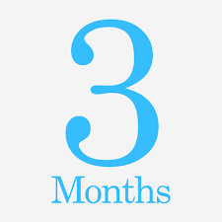
Short Term Goals
My Goal (Specific, Measurable, Achievable, Realistic and Timed):
The most important reasons why I want to work toward this goal are:
The steps I will need to take to reach this goal:
Some things that could interfere with reaching this goal (e.g. personal discomfort, resistance from others):
Possible solutions for things that could interfere:
How important is it to me that I reach this goal?

Slide 105

Long Term Goals
My Goal (Specific, Measurable, Achievable, Realistic and Timed):
The most important reasons why I want to work toward this goal are:
The steps I will need to take to reach this goal:
Some things that could interfere with reaching this goal (e.g. personal discomfort, resistance from others):
Possible solutions for things that could interfere:
How important is it to me that I reach this goal?

Slide 106

The Power of Choice
The SMART Recovery approach emphasises 'empowerment' and the 'power of choice' for those working on addiction recovery. As a family member or friend, we have the power of choice too. We are not ALL-POWERFUL, but we are far from POWER-LESS
We learn:
1. To manage our emotional upsets
2. To change unhelpful responses
3. Challenge unrealistic and unhelpful thinking
4. Effective was to change and improve communication
5. The importance of healthy boundaries
6. The importance of planning non-drinking activities
7. How to reward non addictive behaviour
8. To work on developing our own support system
9. To work on other ways to enrich our lives

Slide 107

Choices Exercise
Take some time to reflect on how your attitudes and outlook have changed
What choices have you made for yourself, what tools have you used ?
How effective have your choices been ?
What has been helpful ?
What hasn't worked ?
What needs work ?
What are some topics or strategies that you'd like to implement in your life ?
'Success is a journey, not a destination'
Ben Sweetland

Slide 108
Choice: Knowing When to STOP
Have I, as consistently as I could, mapped out problem situations and planned more effective, non-confrontational behaviours for myself?
Have I practiced a PIUS communication style?
Have I kept track of how my plans went and adjusted them based on those experiences?
Have I stopped acting as my Loved One’s caretaker and allowed him/her to experience the real consequences of drinking/using?
Have I rewarded my Loved One for non-drinking behaviour and made it as enjoyable as possible to be sober with me and/or the family?
Have I added pleasurable activities to my own life so that I am not totally absorbed by the drinking problems?
Have I figured out when the best windows of opportunity to suggest treatment are, and planned how I would use them?
Have I lined up a reasonable treatment option and made it available to my Loved One?
Is there anything that I thought might help and I meant to do but didn't? Can I see an attractive future with this person?
Once I get over missing my Loved One, will a future without him/her bring me greater peace and happiness than one with him/her?

Slide 109
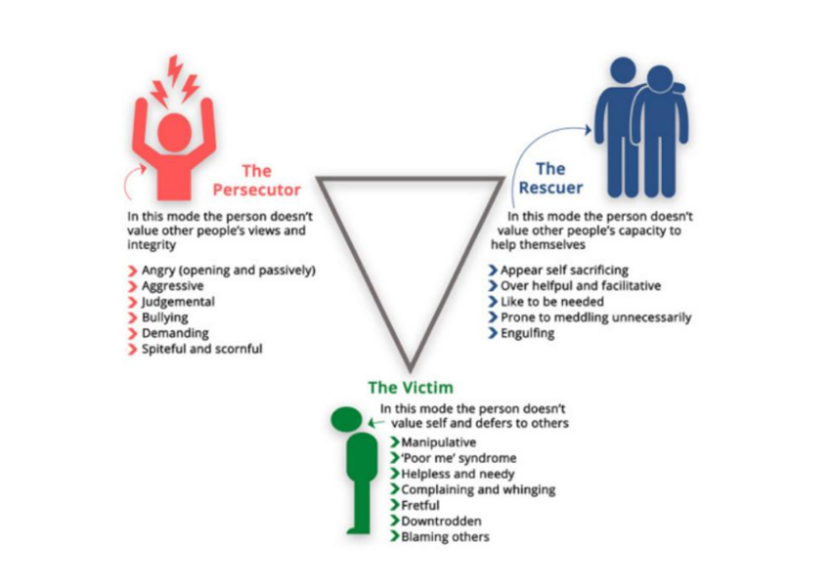

Slide 110
Choice: The Drama Triangle
Realise that you are repeating a pattern.
Under any circumstance, do not become defensive. Keep a neutral attitude
If you find yourself feeling like a victim, learn to take responsibility for yourself instead of blaming others for how your life is turning out
If you find yourself feeling like you’re taking on too much responsibility (rescuer), back off, allowing others to take on their own responsibilities, even allowing others to fail if that happens.
Refrain from the following: blaming, criticizing, accusing, lecturing, scolding, monitoring, threatening, preaching, obsessing, over-reacting, or under-reacting (persecutor). Instead, focus on being neutral.

Slide 111
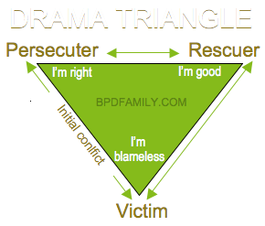
Choice: The Drama Triangle
Who Wins in a Karpman Drama Triangle ? Typically no one.
If we’re in a drama tri­an­gle, what we’re getting is drama.
Ignoring our own wants and needs, denying our own opinions, giving in to whatever the other person wants even if it is harmful, taking the blame for everything, giving up who you are and how you want to live, are all ways that we get stuck in.
It isn’t something to announce to the other person.
It isn’t something to negotiate with the other person.
It isn’t something to threaten the other person with.
We stop participating in the merry-go-round interactions, we stop arguing, we stop worrying about what the other person will do next. This does not mean that we have to stop caring about or loving the other person. We change from being a rescuer in the interaction by making choices and taking actions that work better for us and might even work better for the other person
In 1968, Dr. Stephen Karpman created
the Karpman Drama Triangle

Slide 112
Choice: Detach (With Love)
Loving someone with an addiction is difficult, painful, and often lacks the emotional reward given by normal relationships.
Individuals who are addicted can sometimes appear reckless, and selfish.
Unfortunately, they will not change until they decide to do so for themselves. Even forcing a loved one into rehab doesn’t ensure that they will recover, because they must personally want to be well and change in order to make it happen.
While it is easy to sacrifice yourself to care for and to try to help your Loved One, it most often does not work, and instead creates shared addictions and co-dependency, where you are unable to see a way out because you are too emotionally invested in them.
This is a kind of codependency and without realising it, often enables the Loved One to continue using, because someone is always there for them and caring for them, and typically taking the brunt of their mistakes.
Detaching with love is the process of stepping away from their addictive behaviour, so that their choices and continued use cease to affect you as much, so that you can make the most of your life, stay well and healthy both mentally and physically. If you don't take care of yourself you will be unable to help them when/if they seek their Recovery.
https://lighthousetreatment.com

Slide 113
Choice: Ways to Detach (With Love)
Set Boundaries
Try not to give advice unless asked
Stop focusing on what they are doing
Understand the difference between helping & enabling
Let go of Guilt & Shame
Distance from their problems
Trust you don't have to 'fix' it
Practice Self Care & get support
No matter how much you love someone, you cannot force them to change.
They have to want it for themselves
CounselingRecovery.com

